Slide 1

02504 COMPUTER VISION
Spring 2022
Exam 20th May
Anna Rifé Mata. s212487

Slide 2
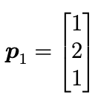
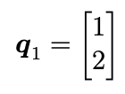
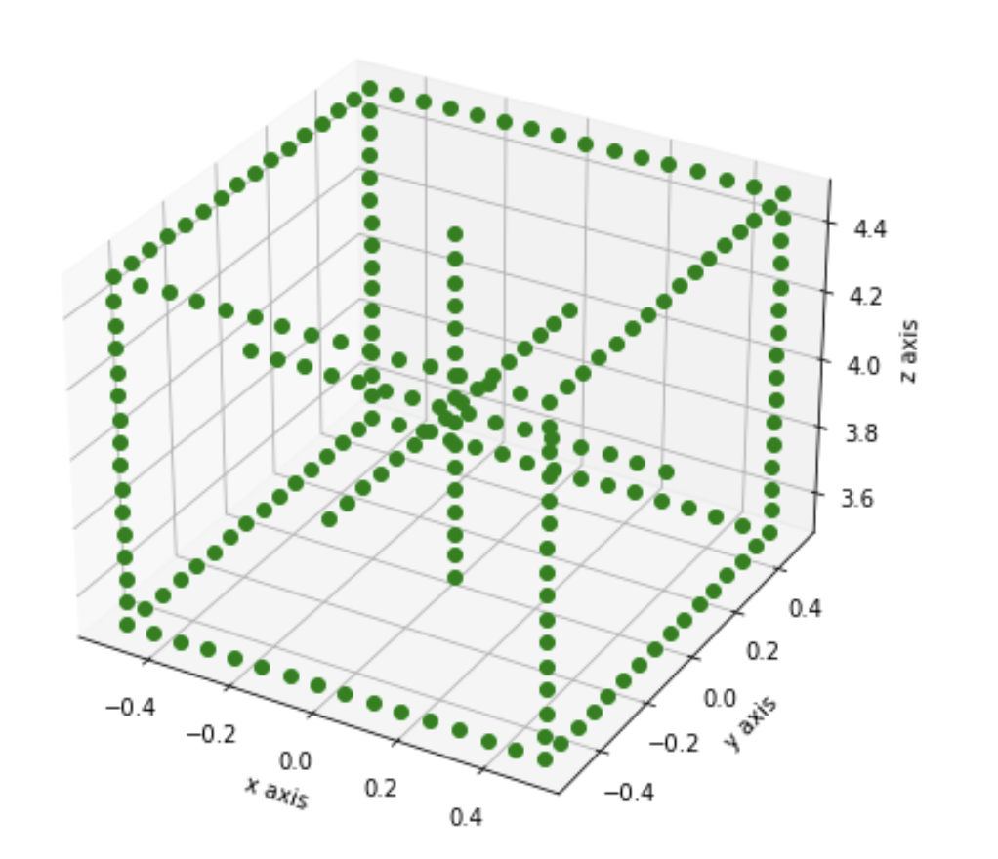
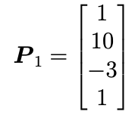
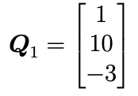
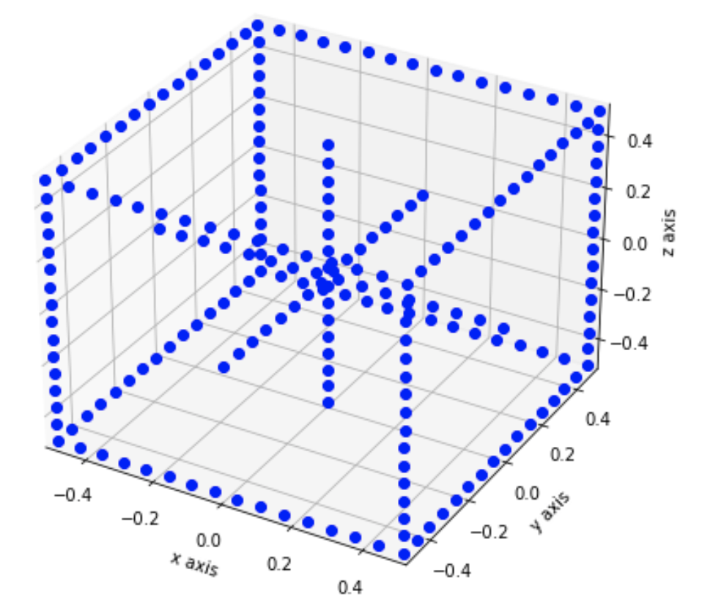
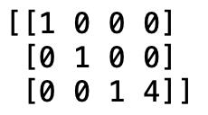
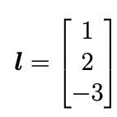
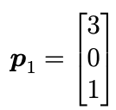
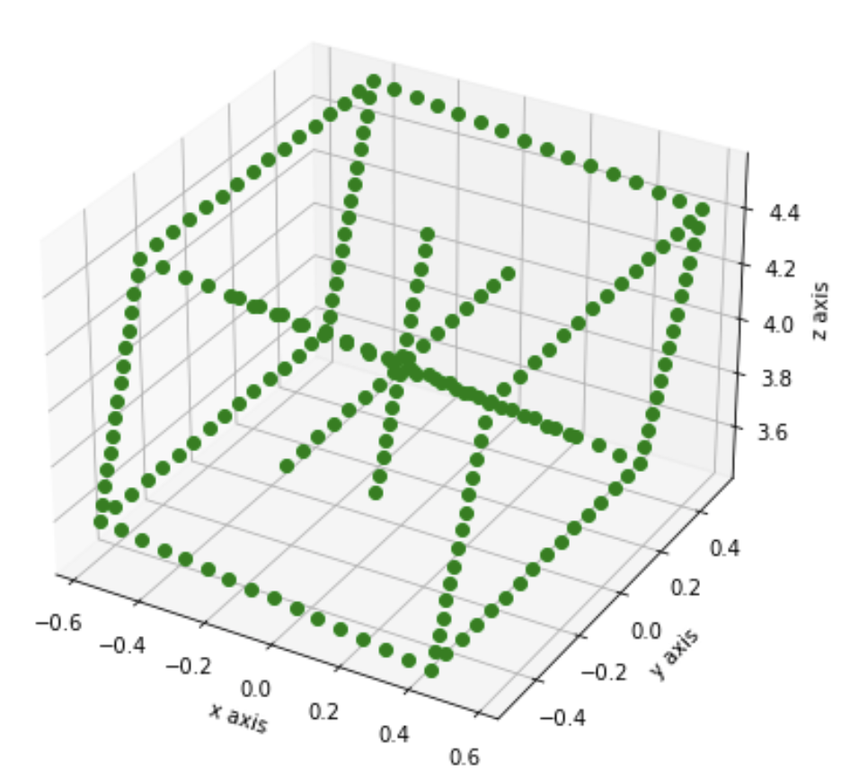
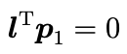
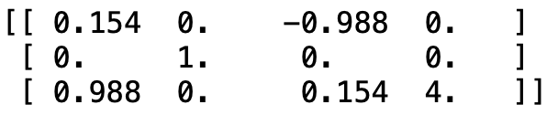
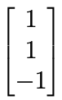
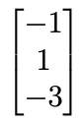
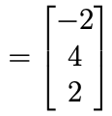
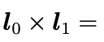
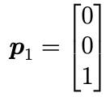
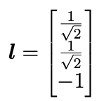
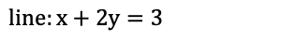

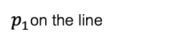
1.Camera Geometry: Rigid and perspective transformations in homogeneous coordinates
Homogeneous coordinates
Inhomogeneous coordinates
Pinhole camera
2D
3D
N (n=16) points between -0.5 and 0.5)
P=
Project points in 3D to the camera
$$line:x+2y=3$$
$p_{1}$on the line
P=
$$d\left(l,p_{1}\right)=1$$

Slide 3
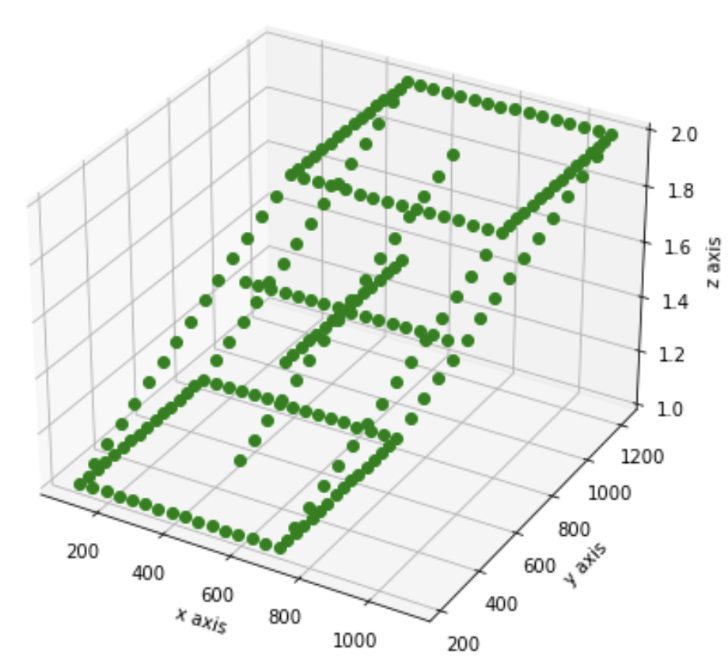
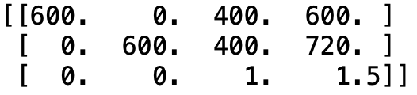
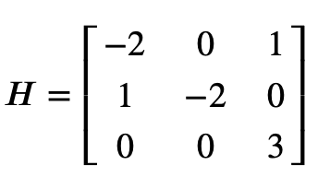
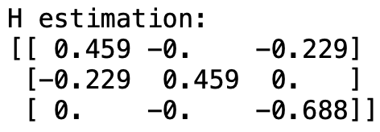
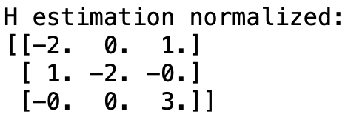
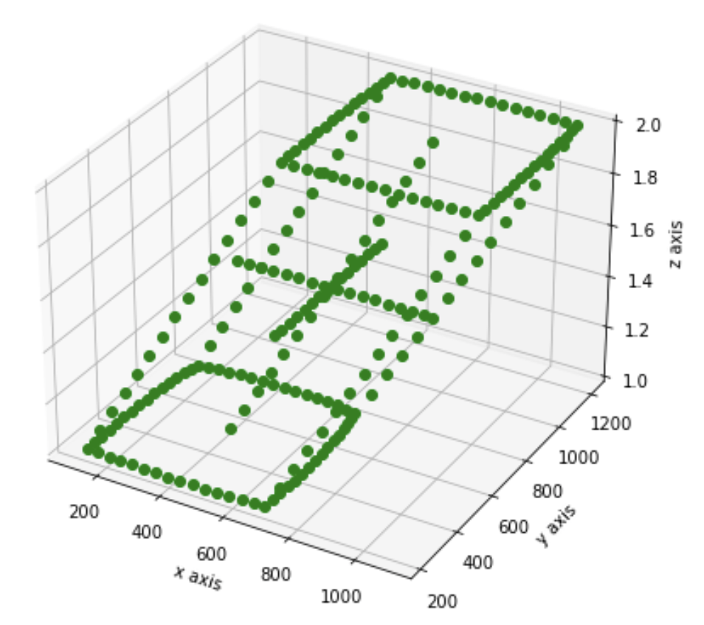
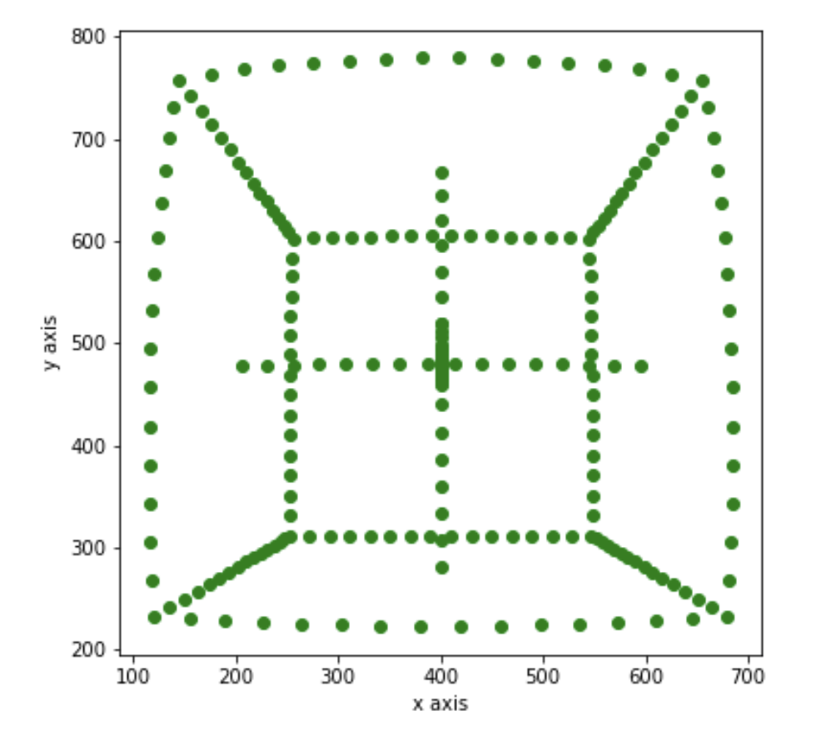
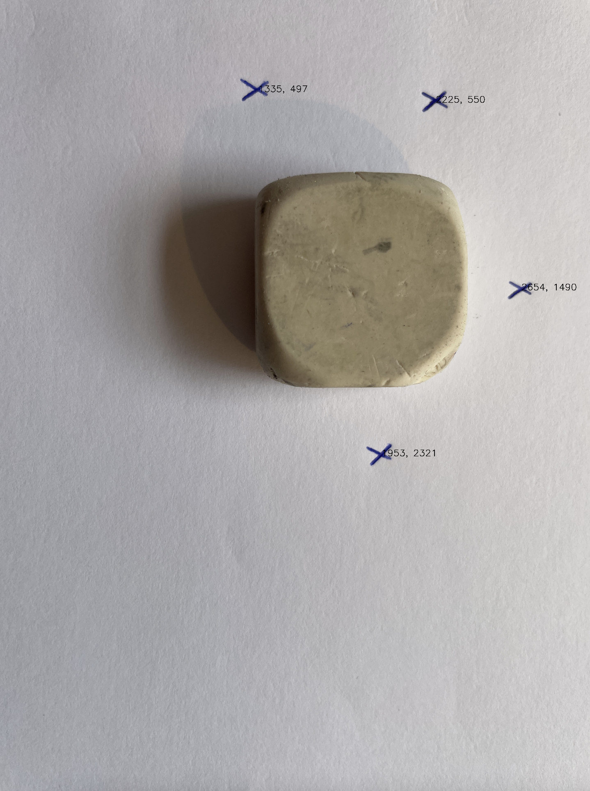
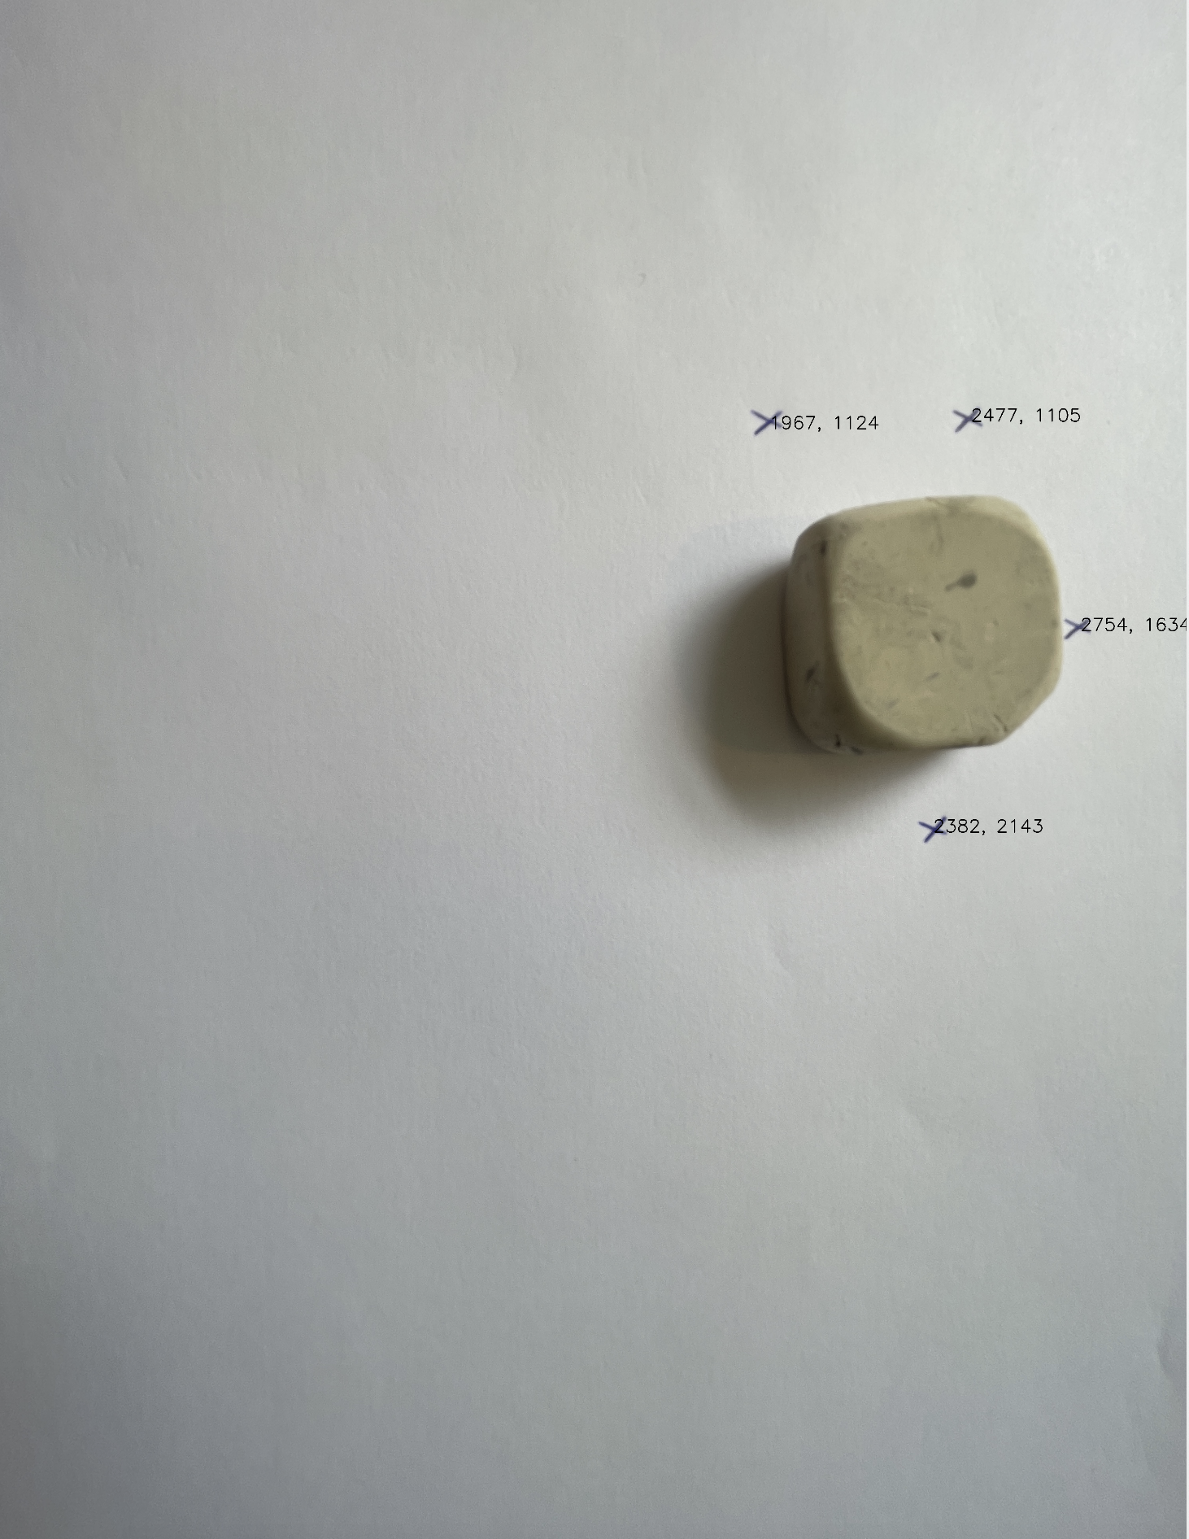
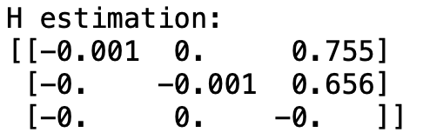
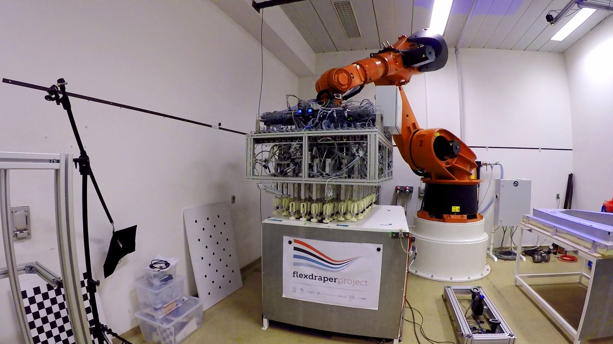
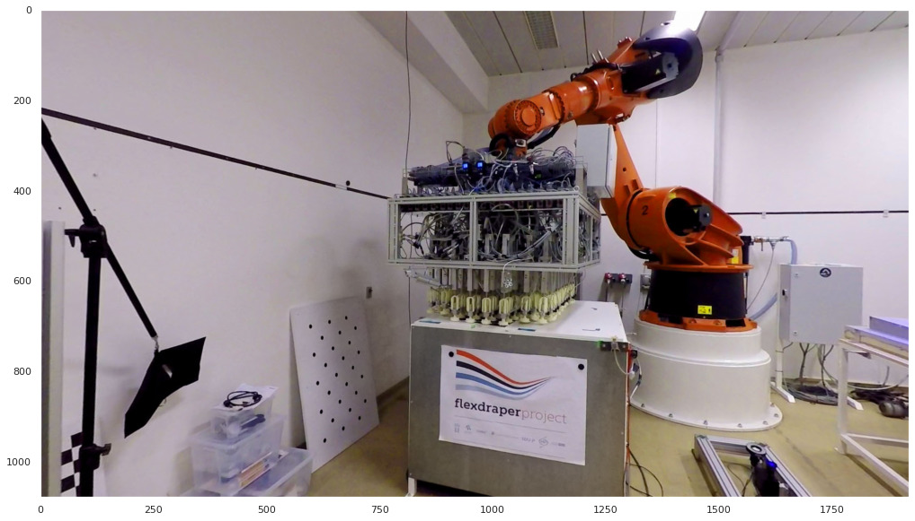
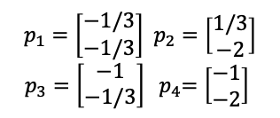
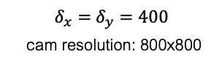
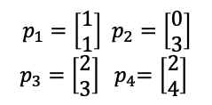
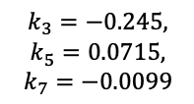
2.Camera Model and Homographies: Rigid and perspective transformations in homogeneous coordinates
Pinhole camera
Homographies
Homography mapping
$p_{1}=\left[\begin{matrix}1 \\ 1\end{matrix}\right]$ $p_{2}=\left[\begin{matrix}0 \\ 3\end{matrix}\right]$
$p_{3}=\left[\begin{matrix}2 \\ 3\end{matrix}\right]$ ${ p}_{4}=\left[\begin{matrix}2 \\ 4\end{matrix}\right]$
$p_{1}=\left[\begin{matrix}−1/3 \\ −1/3\end{matrix}\right]$ $p_{2}=\left[\begin{matrix}1/3 \\ −2\end{matrix}\right]$
$p_{3}=\left[\begin{matrix}−1 \\ −1/3\end{matrix}\right]$ ${ p}_{4}=\left[\begin{matrix}−1 \\ −2\end{matrix}\right]$
P=
$δ_{x}=$ $δ_{y}=400$
cam resolution: 800x800
Are all points captured?
Homography estimation
Lens distortion
Are all points captured?
Homography estimation
Undistort an Image
Undistorted
$$k_{3}=−0.245,$$
$$k_{5}=0.0715,$$
$$k_{7}=−0.0099$$
Image A
Image B

Slide 4
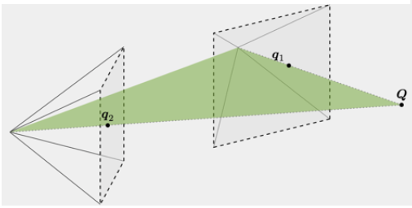
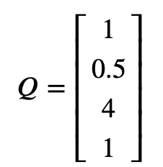
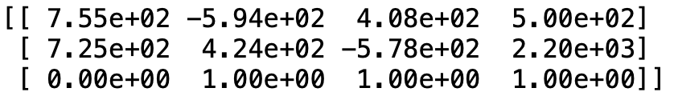
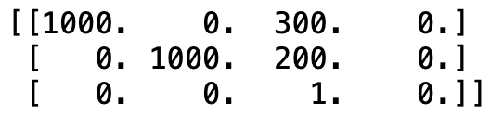
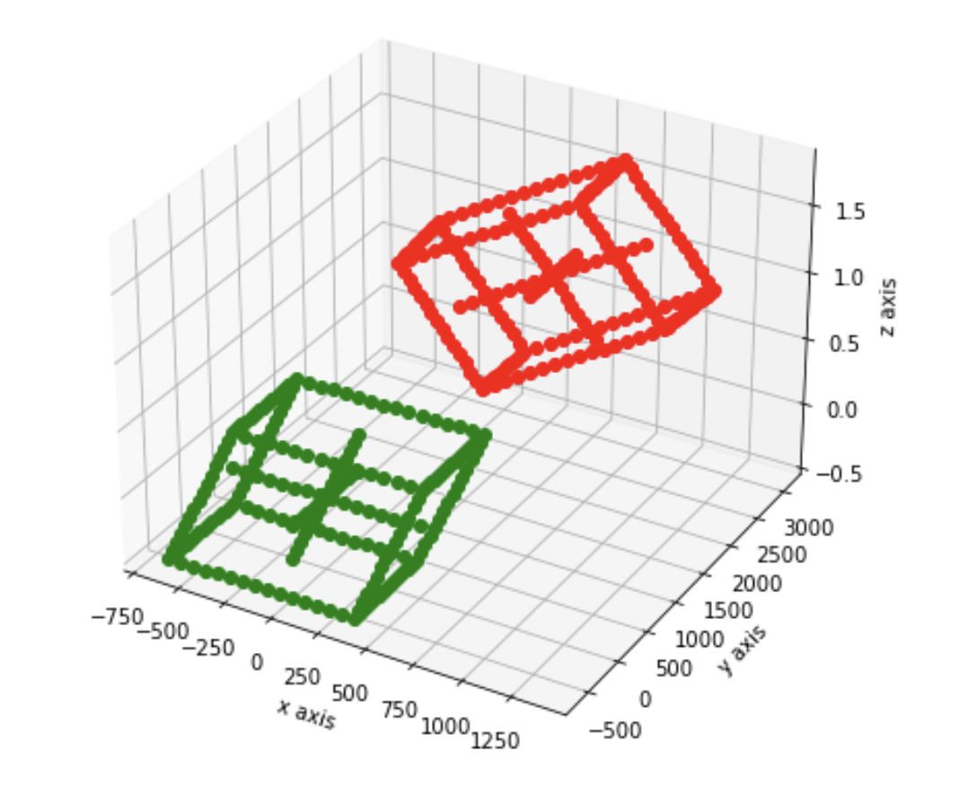
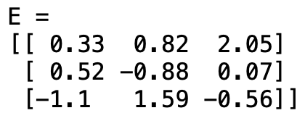
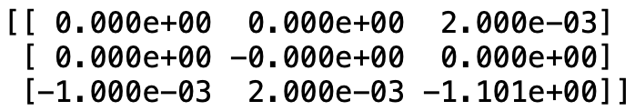
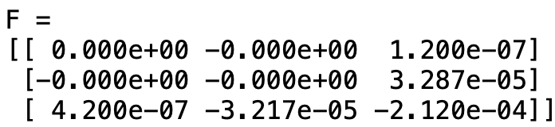
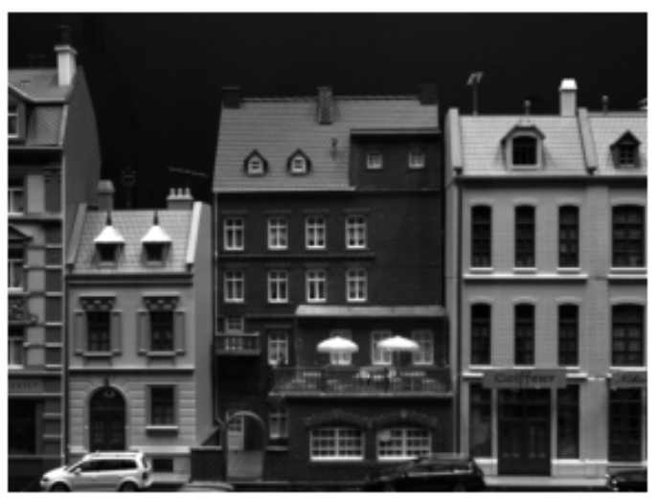
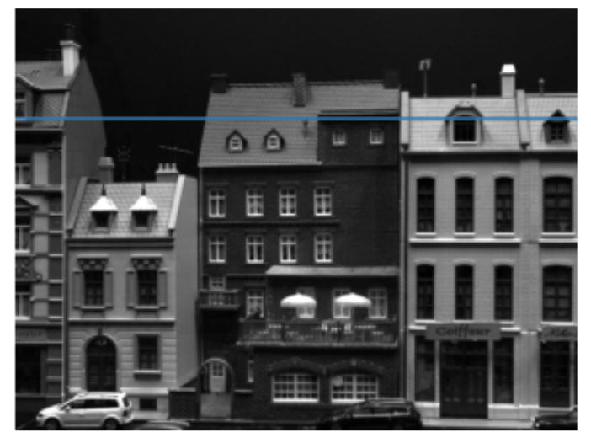
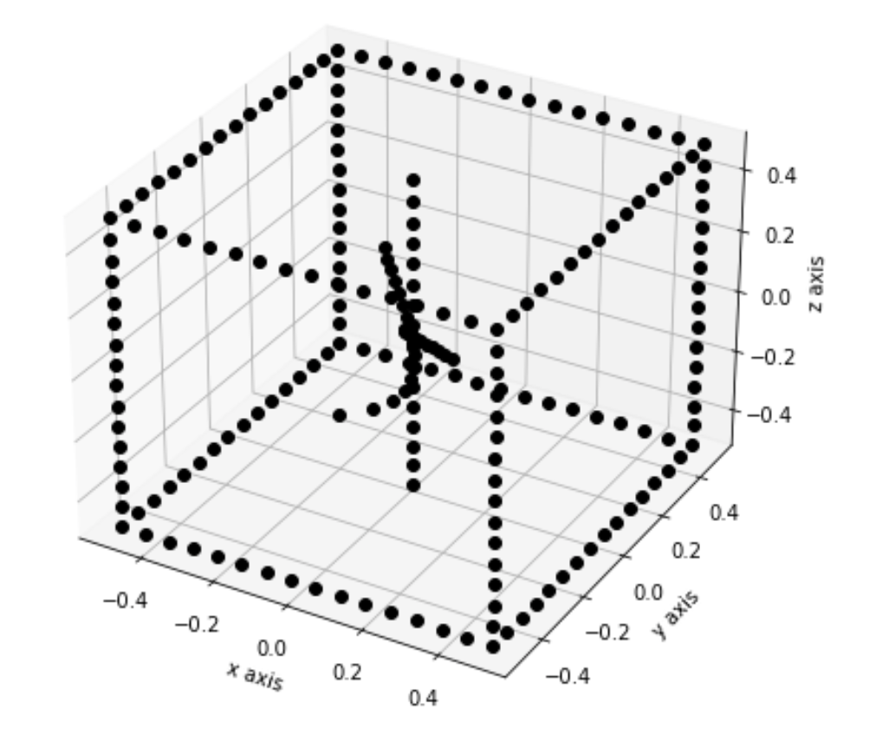
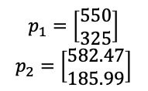

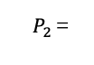
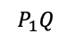


3.Stereo view geometry: Stereo vision and triangulation
Epipolar geometry
Triangulation
$p_{1}=\left[\begin{matrix}550 \\ 325\end{matrix}\right]$ $p_{2}=\left[\begin{matrix}582.47 \\ 185.99\end{matrix}\right]$
3D points Q
$P_{1}$=
$P_{2}$=
$$P_{2}Q$$
$$P_{1}Q$$
F and E matrix calculation
E=
F=
projected points on 2 cameras
Applied Epipolar geometry
F=
(293,155)
Triangulate 2D points
Epipolar line
Image 1
Image 2
$l_{2}=$ ${Fq}_{1}=$

Slide 5




























4.Camera Calibration: DLT and checkboard calibration
DLT method
Zhang’s method
checkboard points $Q_{ij}$
points $q_{ij}$
$$Q_{ij}$$
$$q_{ij}$$
original points Q
P=
1. Homography Estimation
$${{(q}_{ij}=H}_{Ωj}Q)$$
$$H_{Ωa}$$
$$H_{Ωb}$$
$$H_{Ωc}$$
Projection Matrix estimation using DLT
2. B matrix estimation
Non-Normalization of points
Normalization of points
B_{true}=K^{-T}K⁻¹
x scale
3. Estimation of Camera Intrinsics and Extrinsics
K=
Reprojection Error: ${6.6}^{−10}$
Reprojection Error: $3^{−15}$

Slide 6
















5.Nonlinear optimization and camera calibration
Triangulation: Linear Algorithm
Camera Calibration with OpenCV
$\sim$20 images of 400x600
+ noise
3D points Q
(1300,1100,1)
Q’=
(635,435,1)
s₁=1
Triangulation
+
||Q-Q’||₂= 0.021
s₂=20
q₁’=P₁Q’= (1310.49,1089.49,1)
E₁$≈$13.4 pixels
(1,1,0)
q₂’=P₂Q’= (635.53,434.48,1)
E₂$≈$0.67 pixels
q_{ij} : 7x10 detected corners
Camera Calibration
Triangulation: Nonlinear optimization
R_{i} | t_{i} matrices
K=
Residuals:
q_{ij}’=P_{i}Q
Initial guess: Q’
Optimization: Least Squares
(P₁Q’ - q₁ ) + (P₂Q’ - q₂)
reprojection:
reprojection error: ||q_{ij} – q_{ji}’||₂
$$δ_{x}{ , δ}_{y}$$
Optimization of Q’
||Q-Q’||₂= 0.0021
q₁’=P₁Q’= (1310.49,1089.49,1)
E₁$≈$1.34 pixels
q₂’=P₂Q’= (635.53,434.48,1)
E₂$≈$0.067 pixels
r.error $≈$ 5.77
img 11

Slide 7


















6.Simple Features: Feature extraction
Harris corner detector
Canny edge detection
(I $∗$ g) $∗$ g^{T}
Gaussian Smoothing:
$σ$= 5
I_{x}=I $∗$ g’
I_{y}=I $∗$ g’^{T}
Hessian Smoothing:
$σ$= 5
$ε$= 5
Non-Maximum suppression 4

Slide 8








7.Robust Model Fitting
HOUGH TRANFROM & RANSAC
2 Points – Line Fitting
Nº of Inliers given t
Iteration 1
15 inliers
Set nº iterations
Stopping Criteria: Fraction of inliers
RANSAC
Minimize RMSE (PCA)
On inliers
Iteration n
2 inliers

Slide 9




















8.Blobs and SIFT features
BLOB Detection
SIFT Detection
$$σ_{1}=5$$
$$σ_{2}=7$$
Hessian g’’(x)
keypoints
= 7141
keypoints
= 9843
DoG = ${(σ}_{2}$- $σ_{1})/10$
Laplacian $σ=5$
Trace(H) = Degree of change on Intensity (Edges)
Matches=7979, with Ratio Test:0.2 → good matches=572
Scale
DoG
1.2
Extrema Localization
$$−$$
2.4
BLOB Detection
Matches = 4299
Ratio test = 0.7
G Matches = 112
$$−$$
4.8
$$−$$
9.6
$$−$$
19.2
$$−$$
Matches = 48211
Ratio test = 0.7
G Matches = 28
38.4
$$−$$
76.8

Slide 10











9. Geometry Constrained Feature Matching
The Eight Point Algorithm
Fundamental matrix estimation using RANSAC
F_{true}=
F matrix estimation
8 random matches
F_{estimated} =
F matrix estimation
Max. num of inliers: 83
e=F_{true} - scale·F_{estimated} =
N iter
F_{estimated} =
Inliers?
if d < 3.84·$σ^{2}$
Feature Matching
d: Sampson’s distance
F_{true} =
SIFT detection
SIFT detection
Best model?
Accuracy: 99.97%
keypoints= 3749
keypoints= 3628
Own images:
Matches=2086, with crosscheck
Max. num of inliers: 257 (out of 34372 matches)
F_{estimated} =

Slide 11





10. Image Stitching
Feature Matching
Homography estimation using RANSAC
Warping Images:
4 random matches
H matrix estimation
SIFT detection, keypoints= 8424
SIFT detection, keypoints= 6235
N iter
Matches=2455
Inliers?
if d < 3.84·$σ^{2}$
dist(H, p_{1i}, p_{2i})
Best model?
Max. num of inliers: 2455
500’s first matches
H_{estimated} =

Slide 12


11-12. Visual Odometry
Feature Matching
K =
Img1
Matches_{1→2}
Img2
Matches_{2→3}
Img3

Slide 13
13. Structured Light: 3D scanning
Warping Images:

